Slide 1


Kalman Filter
Philipp Schön (5121059)
Constantin Thein (5121017)

Slide 2
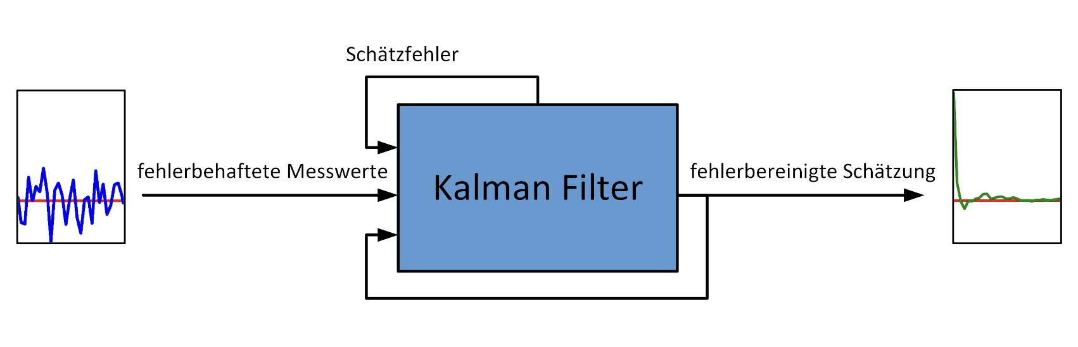
Kalman Filter
estimation error
inacurate measurements
error-corrected estimate

Slide 3
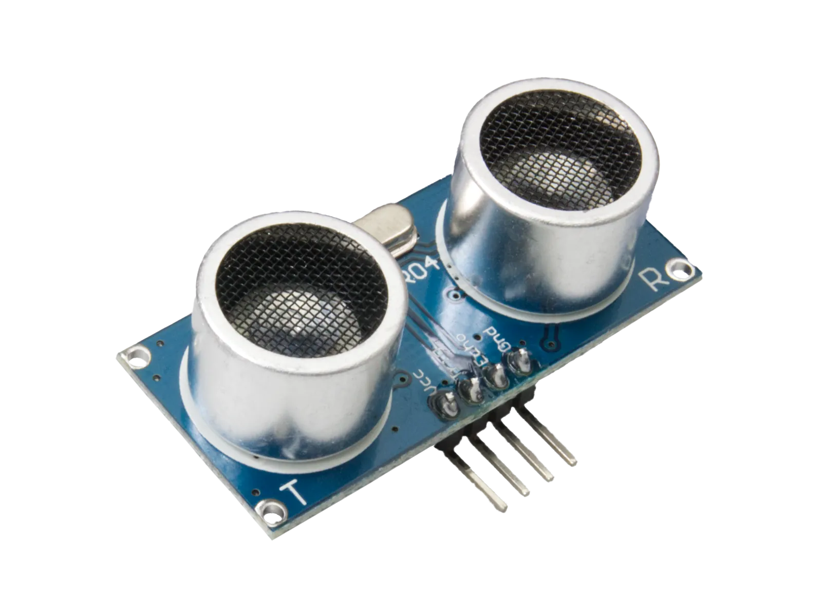
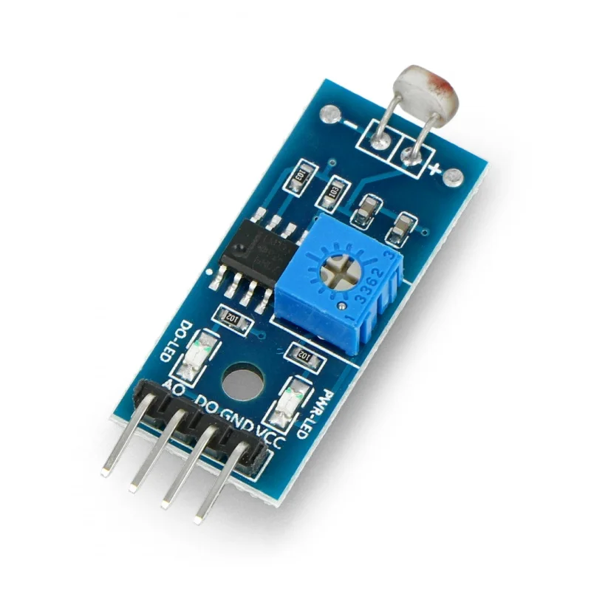
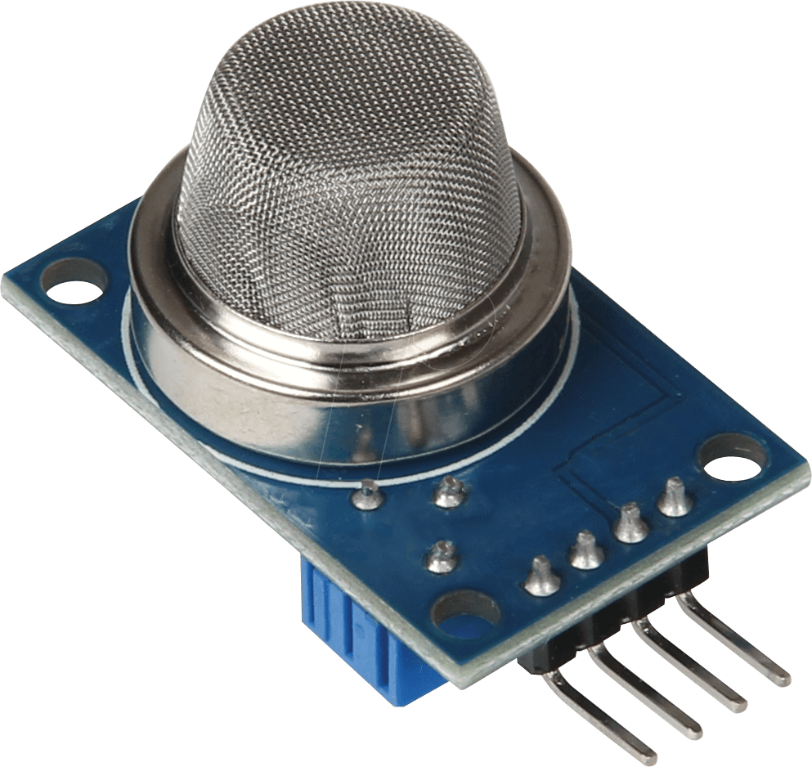
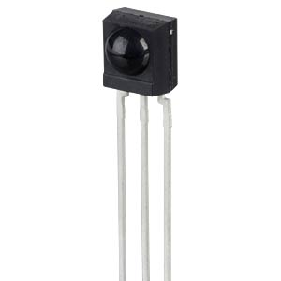
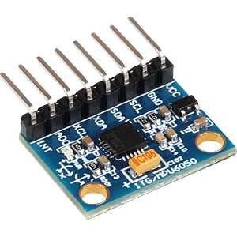
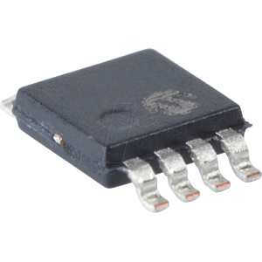
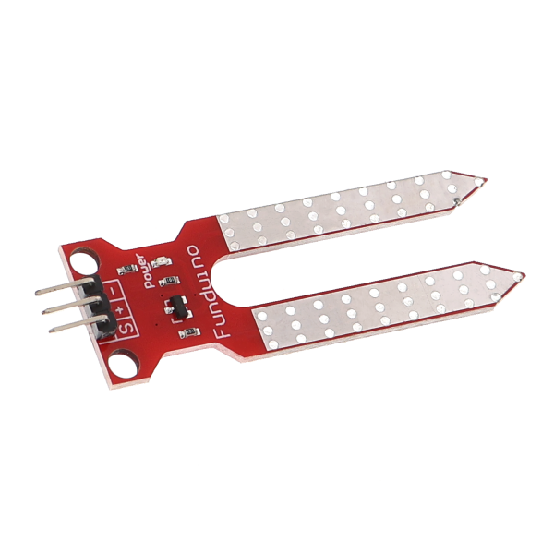
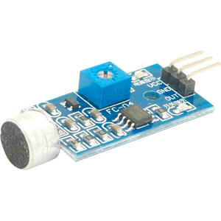
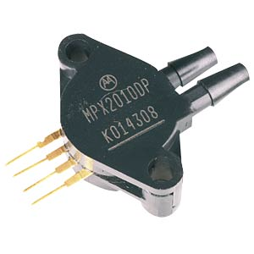
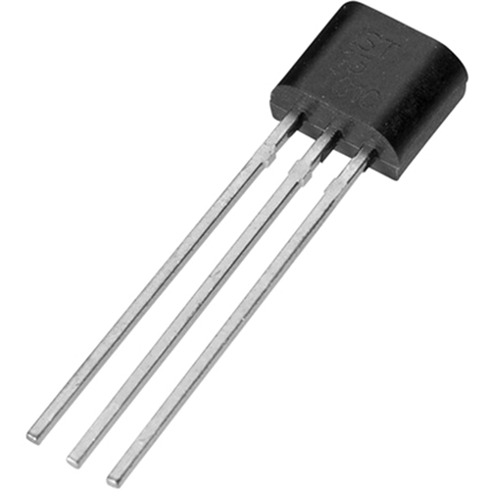
Sensors susceptible to failure
Light sensor (photoresistor)
Ultrasonic sensor
Infrared sensor
Temperature sensor (thermoelectric)
Magnetic field sensor
Gas and air quality sensor
Humidity sensor
Motion sensor (accelerometer)
Pressure sensor
Sound sensor

Slide 4
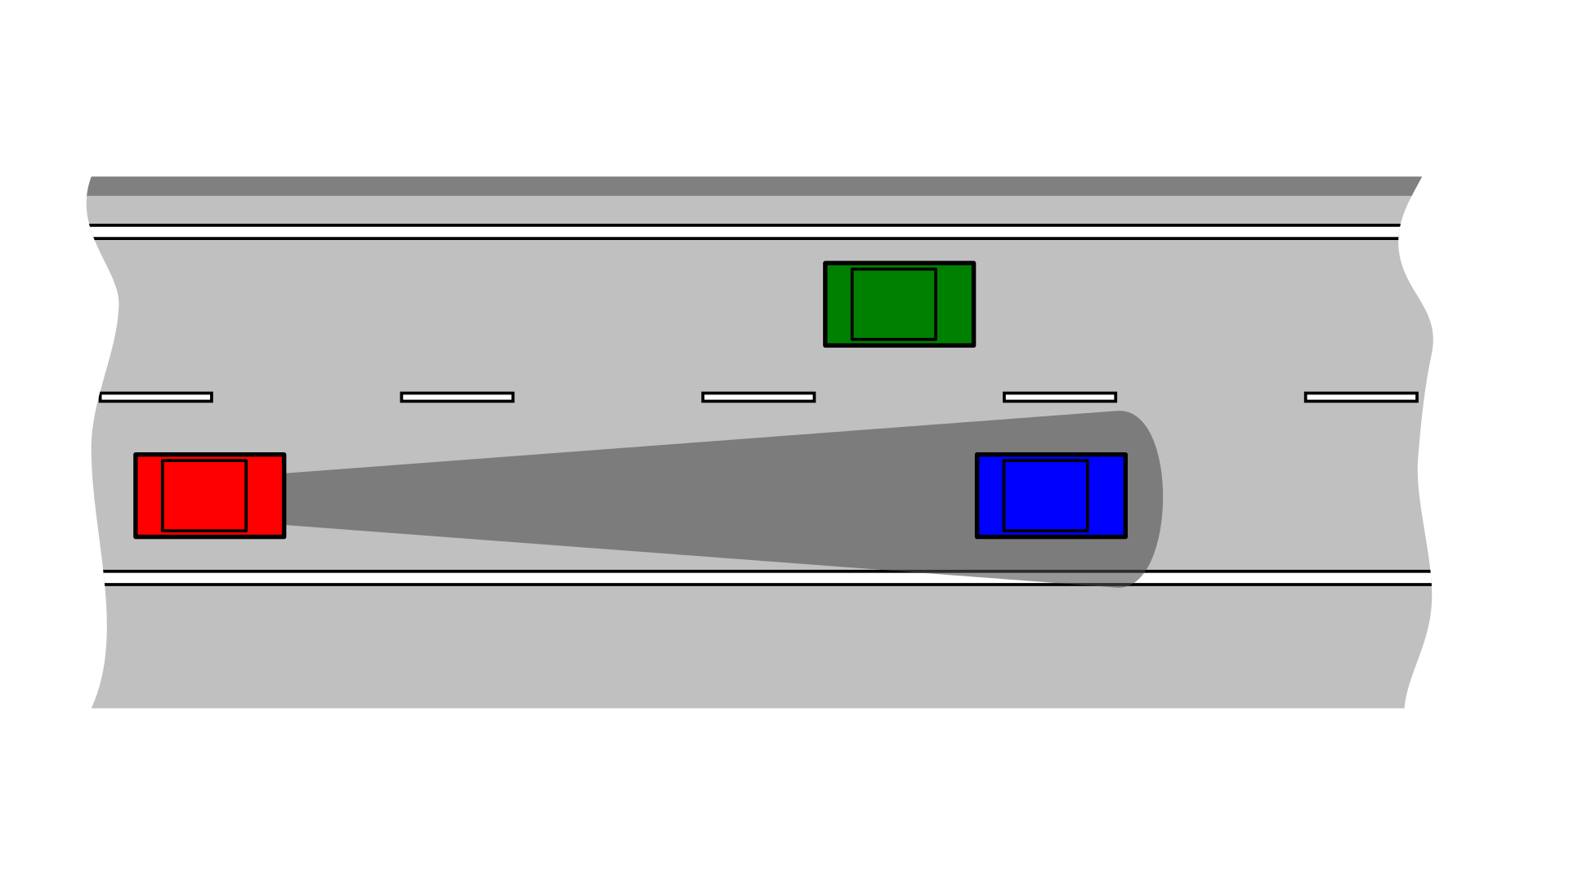
Table of contents
1. Explanation of the Kalman filter
1.2 Function
1.3 Use cases
2. Experiment
2.1 Setup
2.2 Procedure
2.3 Simulation
2.4 Result
3. Conclusion

Slide 5
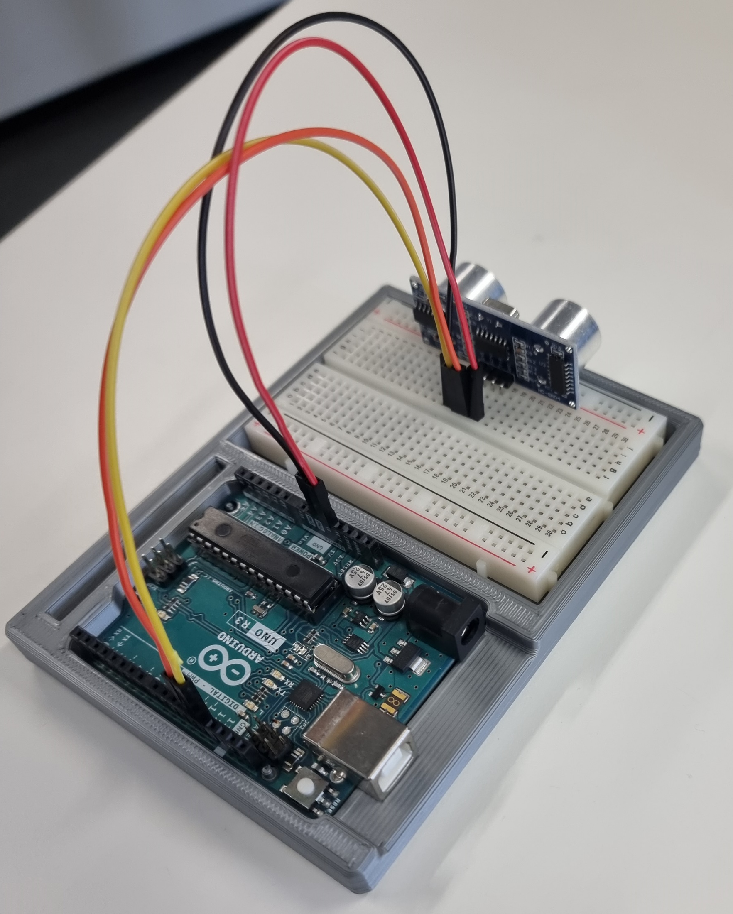
Ultrasound Sensor
Hardware:
Arduino Uno R3
Ultrasonic sensor module HC-SR04

Slide 6
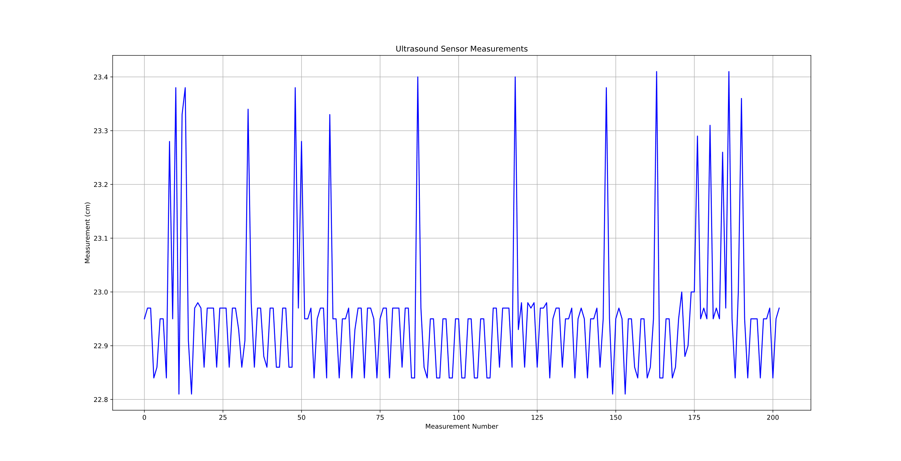
Data from Sensor

Slide 7
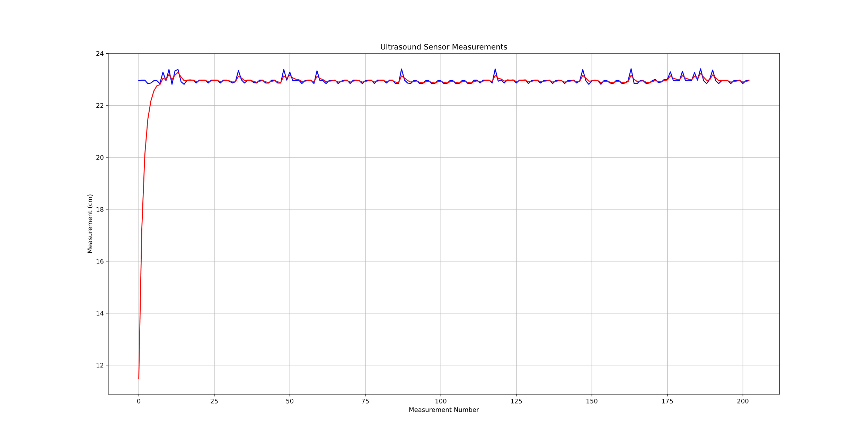
First Try with Kalman-Filter

Slide 8
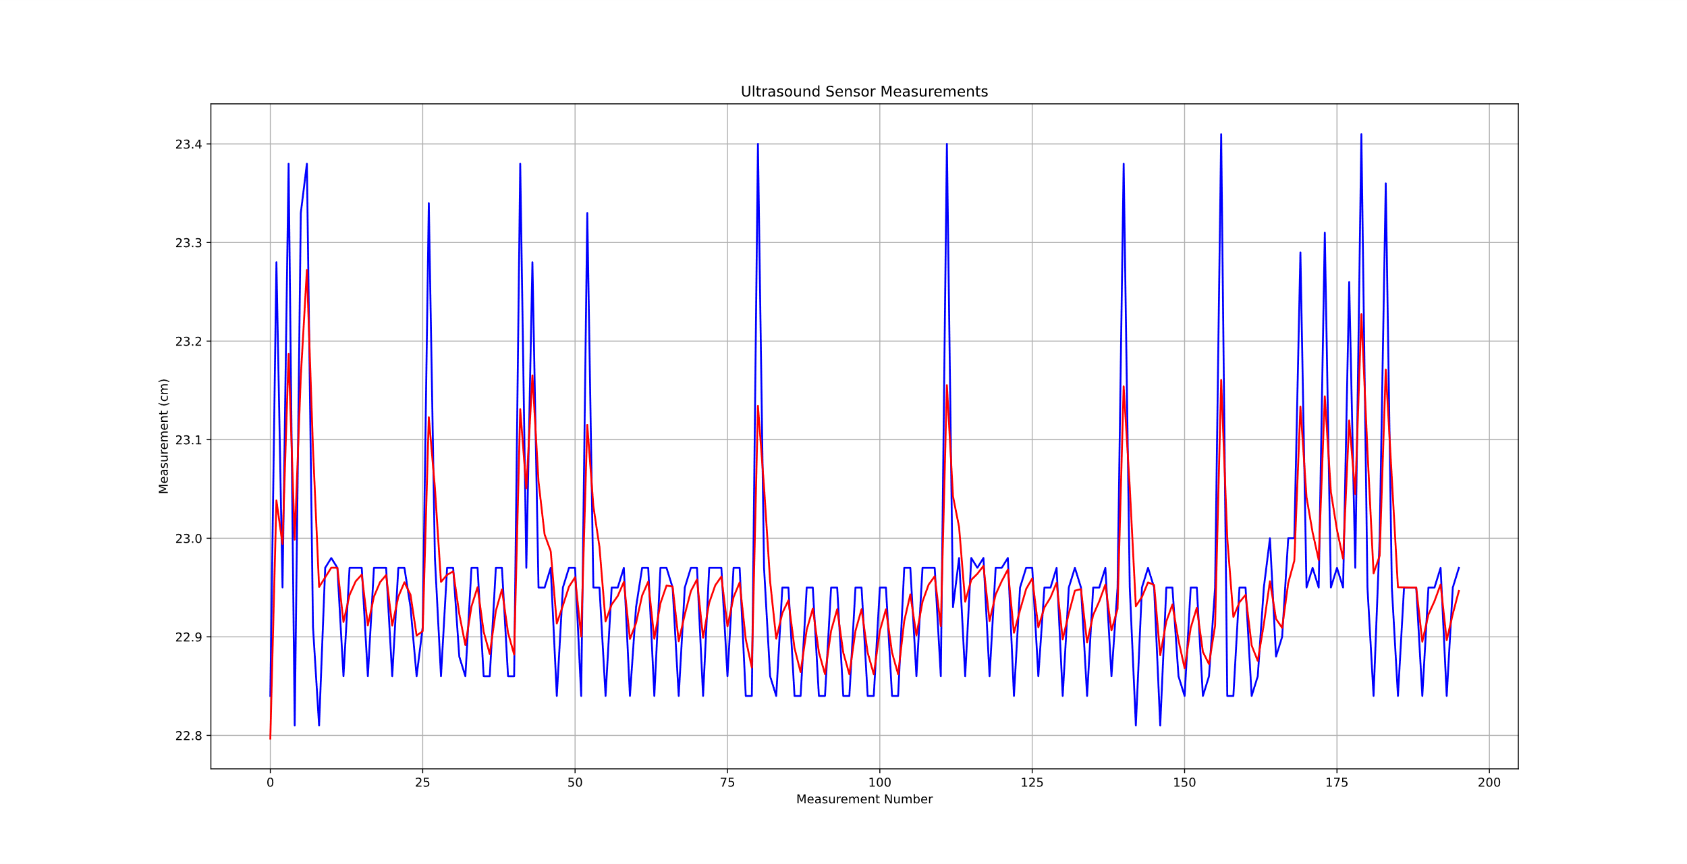
First Try with Kalman-Filter

Slide 9
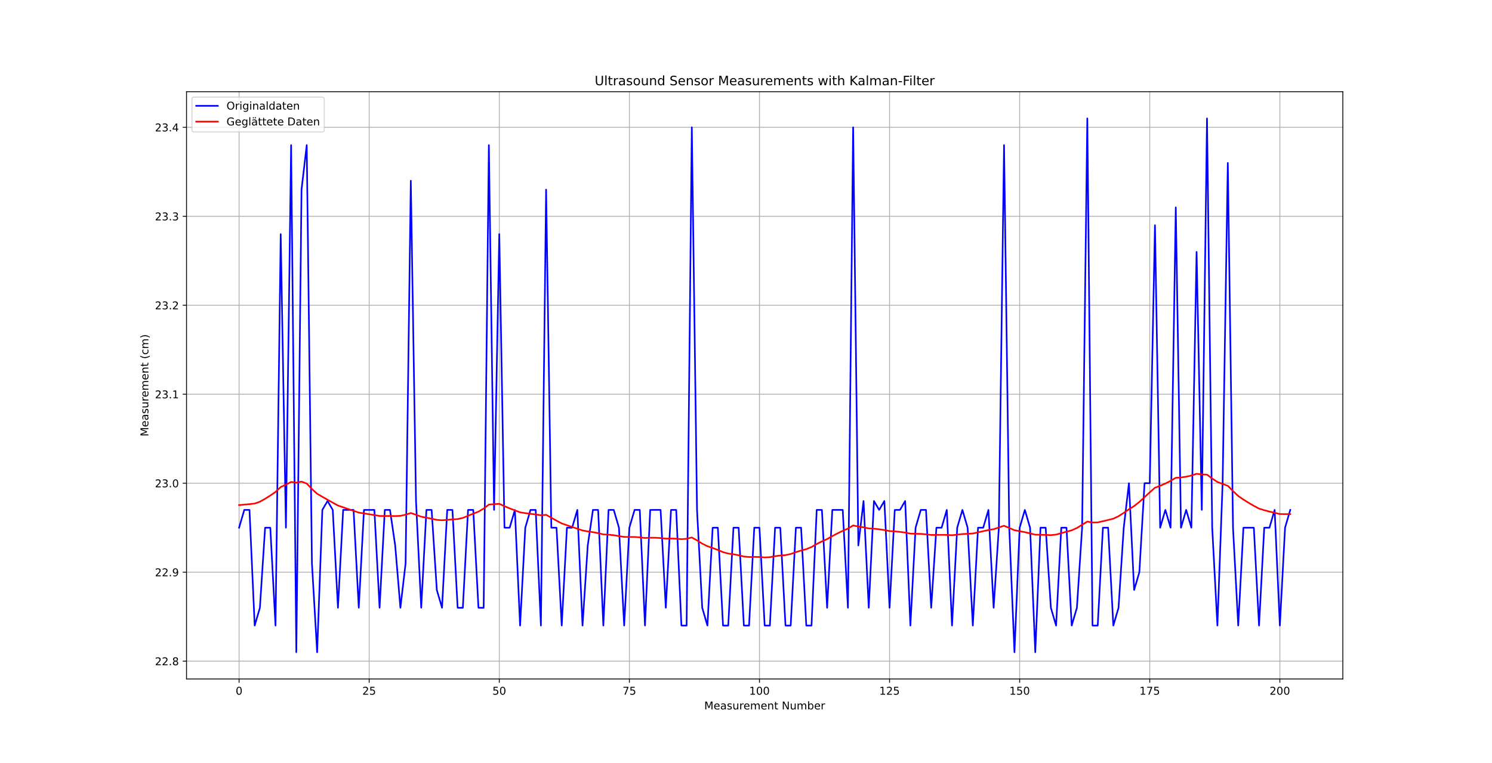
First Try with Kalman-Filter

Slide 10
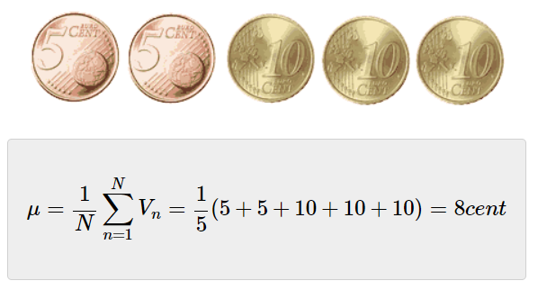
Mean

Slide 11
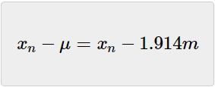
Variance
 | Player 1 | Player 2 | Player 3 | Player 4 | Player 5 | Mean
Team A | 1.89m | 2.10m | 1.75m | 1.98m | 1.85m | 1.914m
Team B | 1.94m | 1.90m | 1.97m | 1.89m | 1.87m | 1.914m
 | Player 1 | Player 2 | Player 3 | Player 4 | Player 5
Team A | -0.024m | 0.186m | -0.164m | 0.066m | -0.064m
Team B | 0.026m | -0.014m | 0.056m | -0.024m | -0.044m

Slide 12
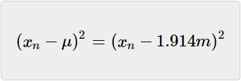
Variance
 | Player 1 | Player 2 | Player 3 | Player 4 | Player 5
Team A | -0.024m | 0.186m | -0.164m | 0.066m | -0.064m
Team B | 0.026m | -0.014m | 0.056m | -0.024m | -0.044m
 | Player 1 | Player 2 | Player 3 | Player 4 | Player 5
Team A | 0.000576m² | 0.034596m² | 0.026896m² | 0.004356m² | 0.004096m²
Team B | 0.000676m² | 0.000196m² | 0.003136m² | 0.000576m² | 0.001936m²

Slide 13
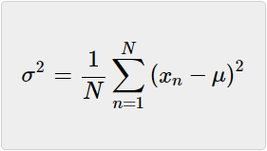
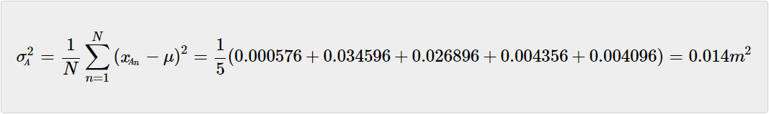
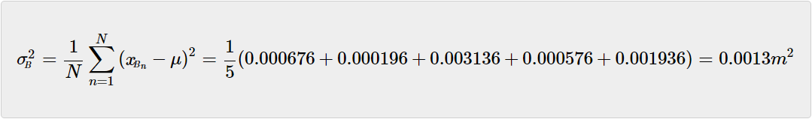
Variance

Slide 14
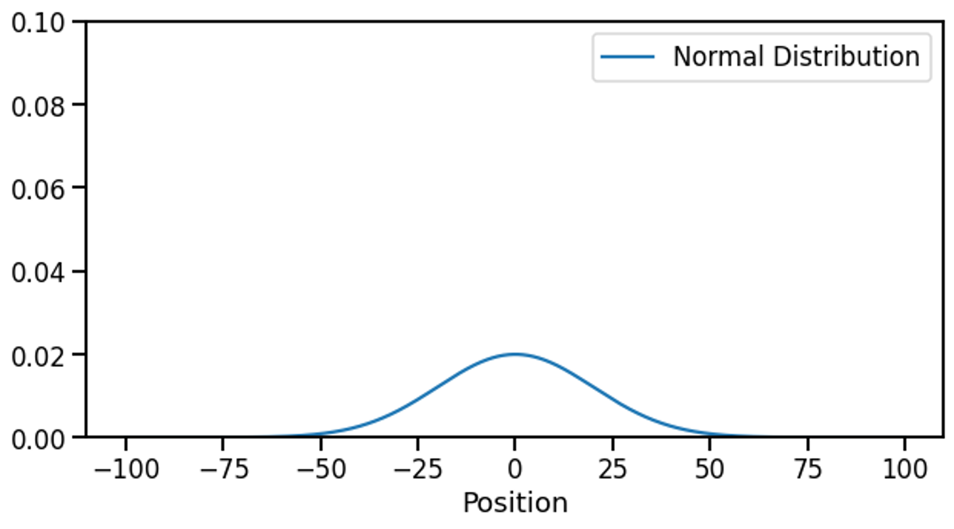
Kalman-Filter explained
mean = 0.0
var = 20.0

Slide 15
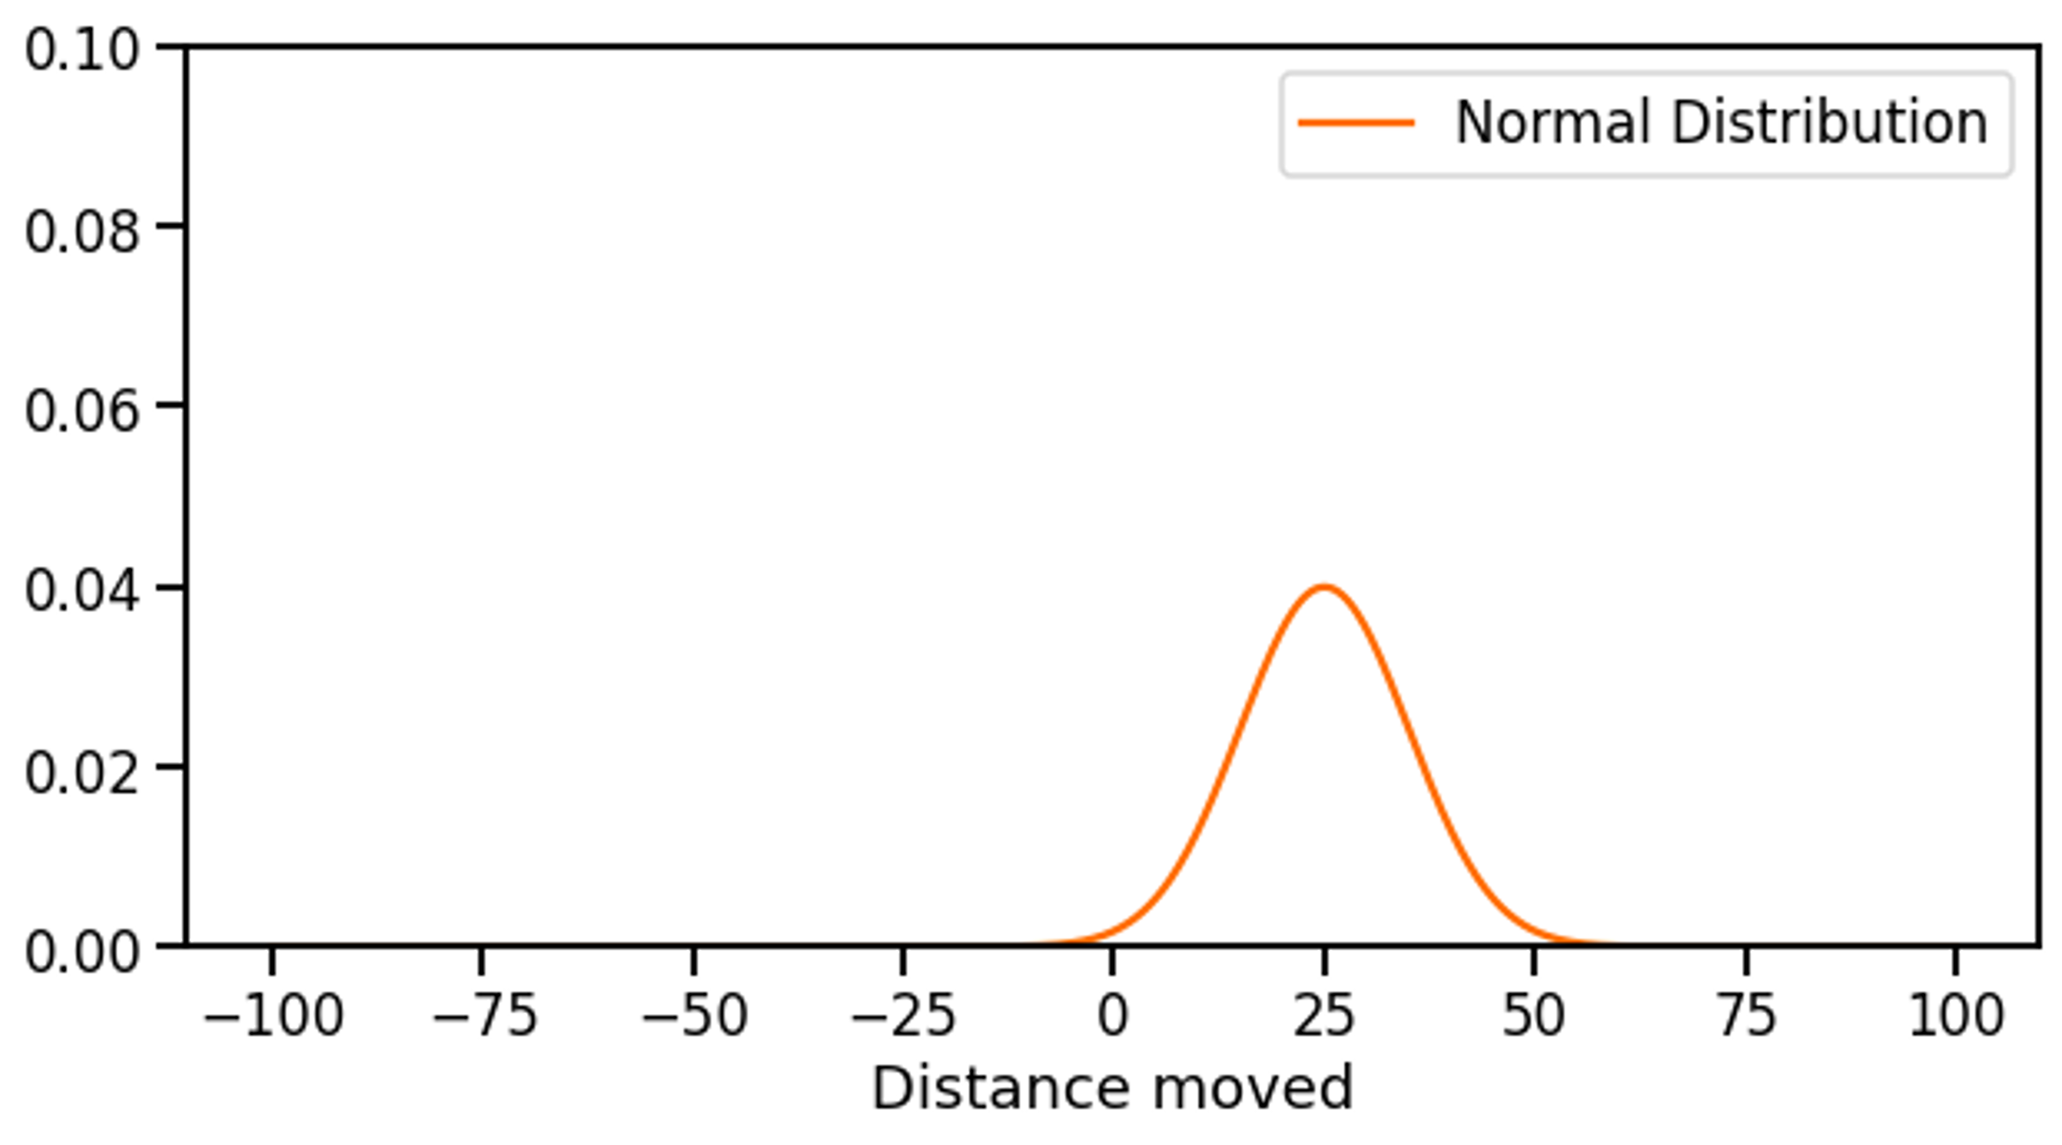
Kalman-Filter explained
meanMove = 25.0
varMove = 10.0

Slide 16
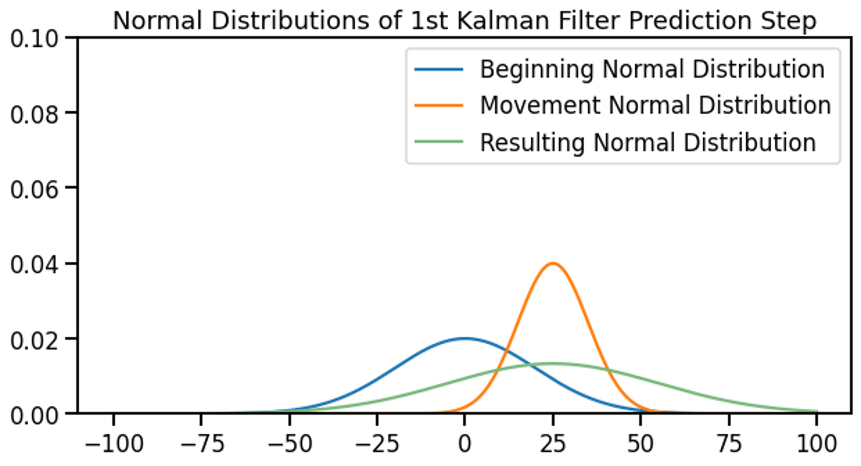
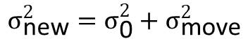
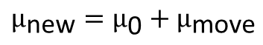
Kalman-Filter explained
$$μ_{\text{new}}=μ_{\text{0}}+μ_{\text{move}}$$
$$σ_{\text{new}}^{2}=σ_{\text{0}}^{2}+σ_{\text{move}}^{2}$$

Slide 17
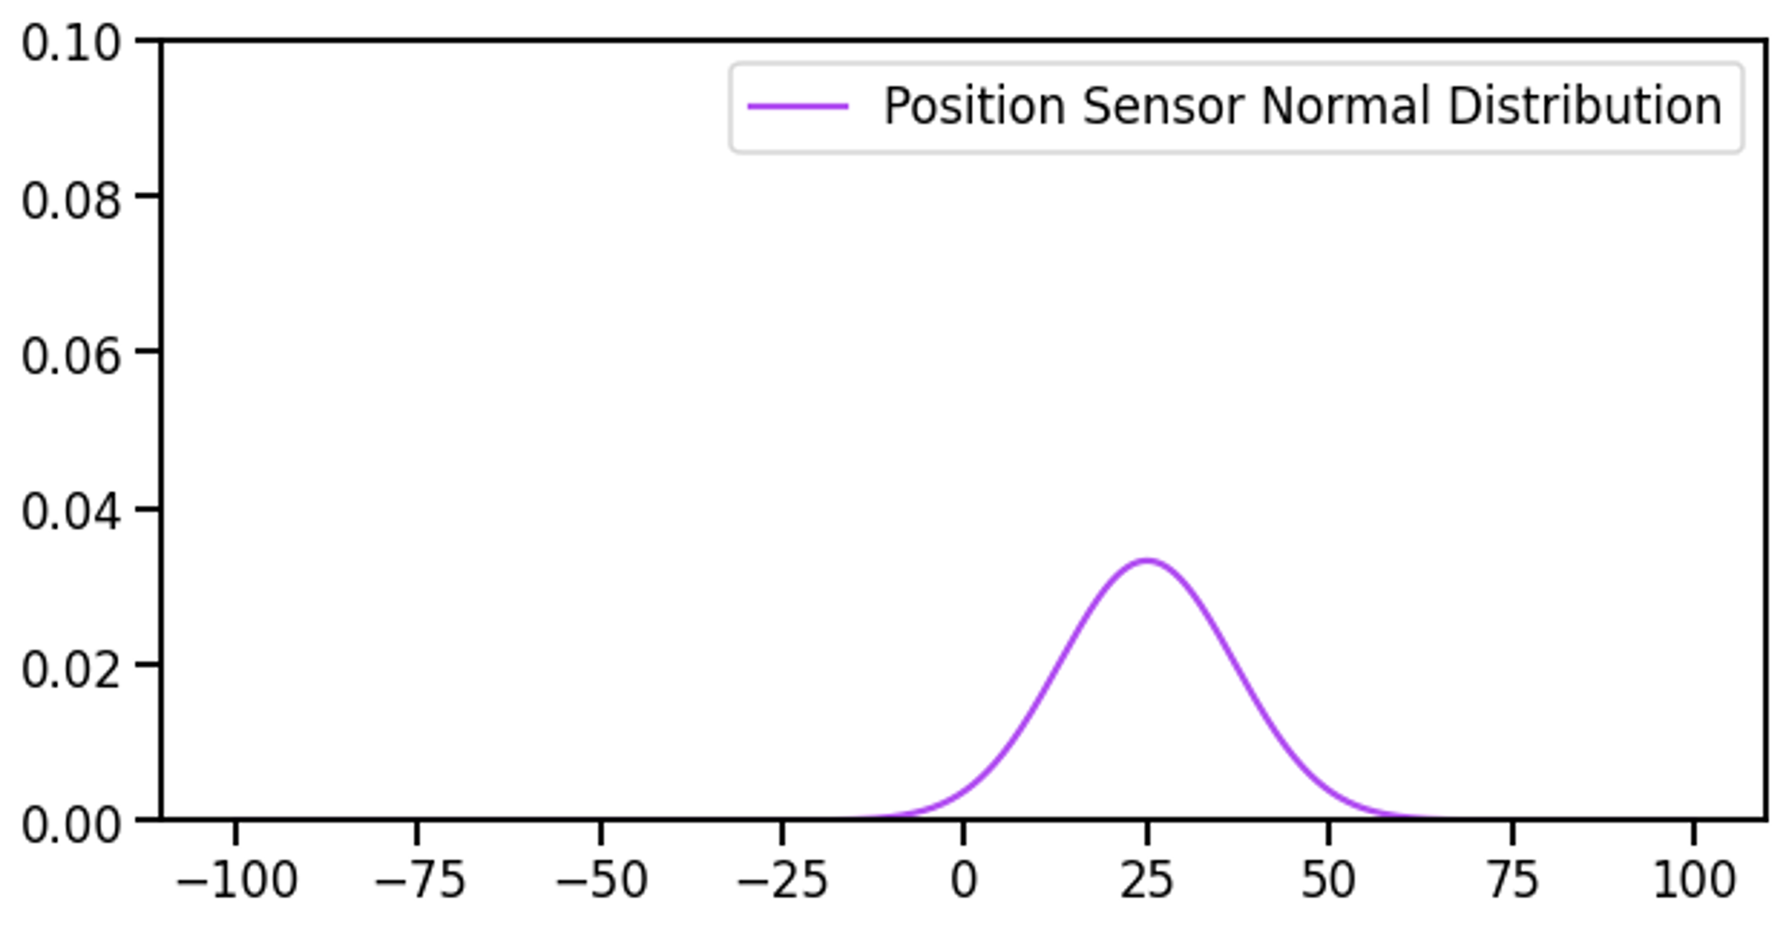
Kalman-Filter explained

Slide 18
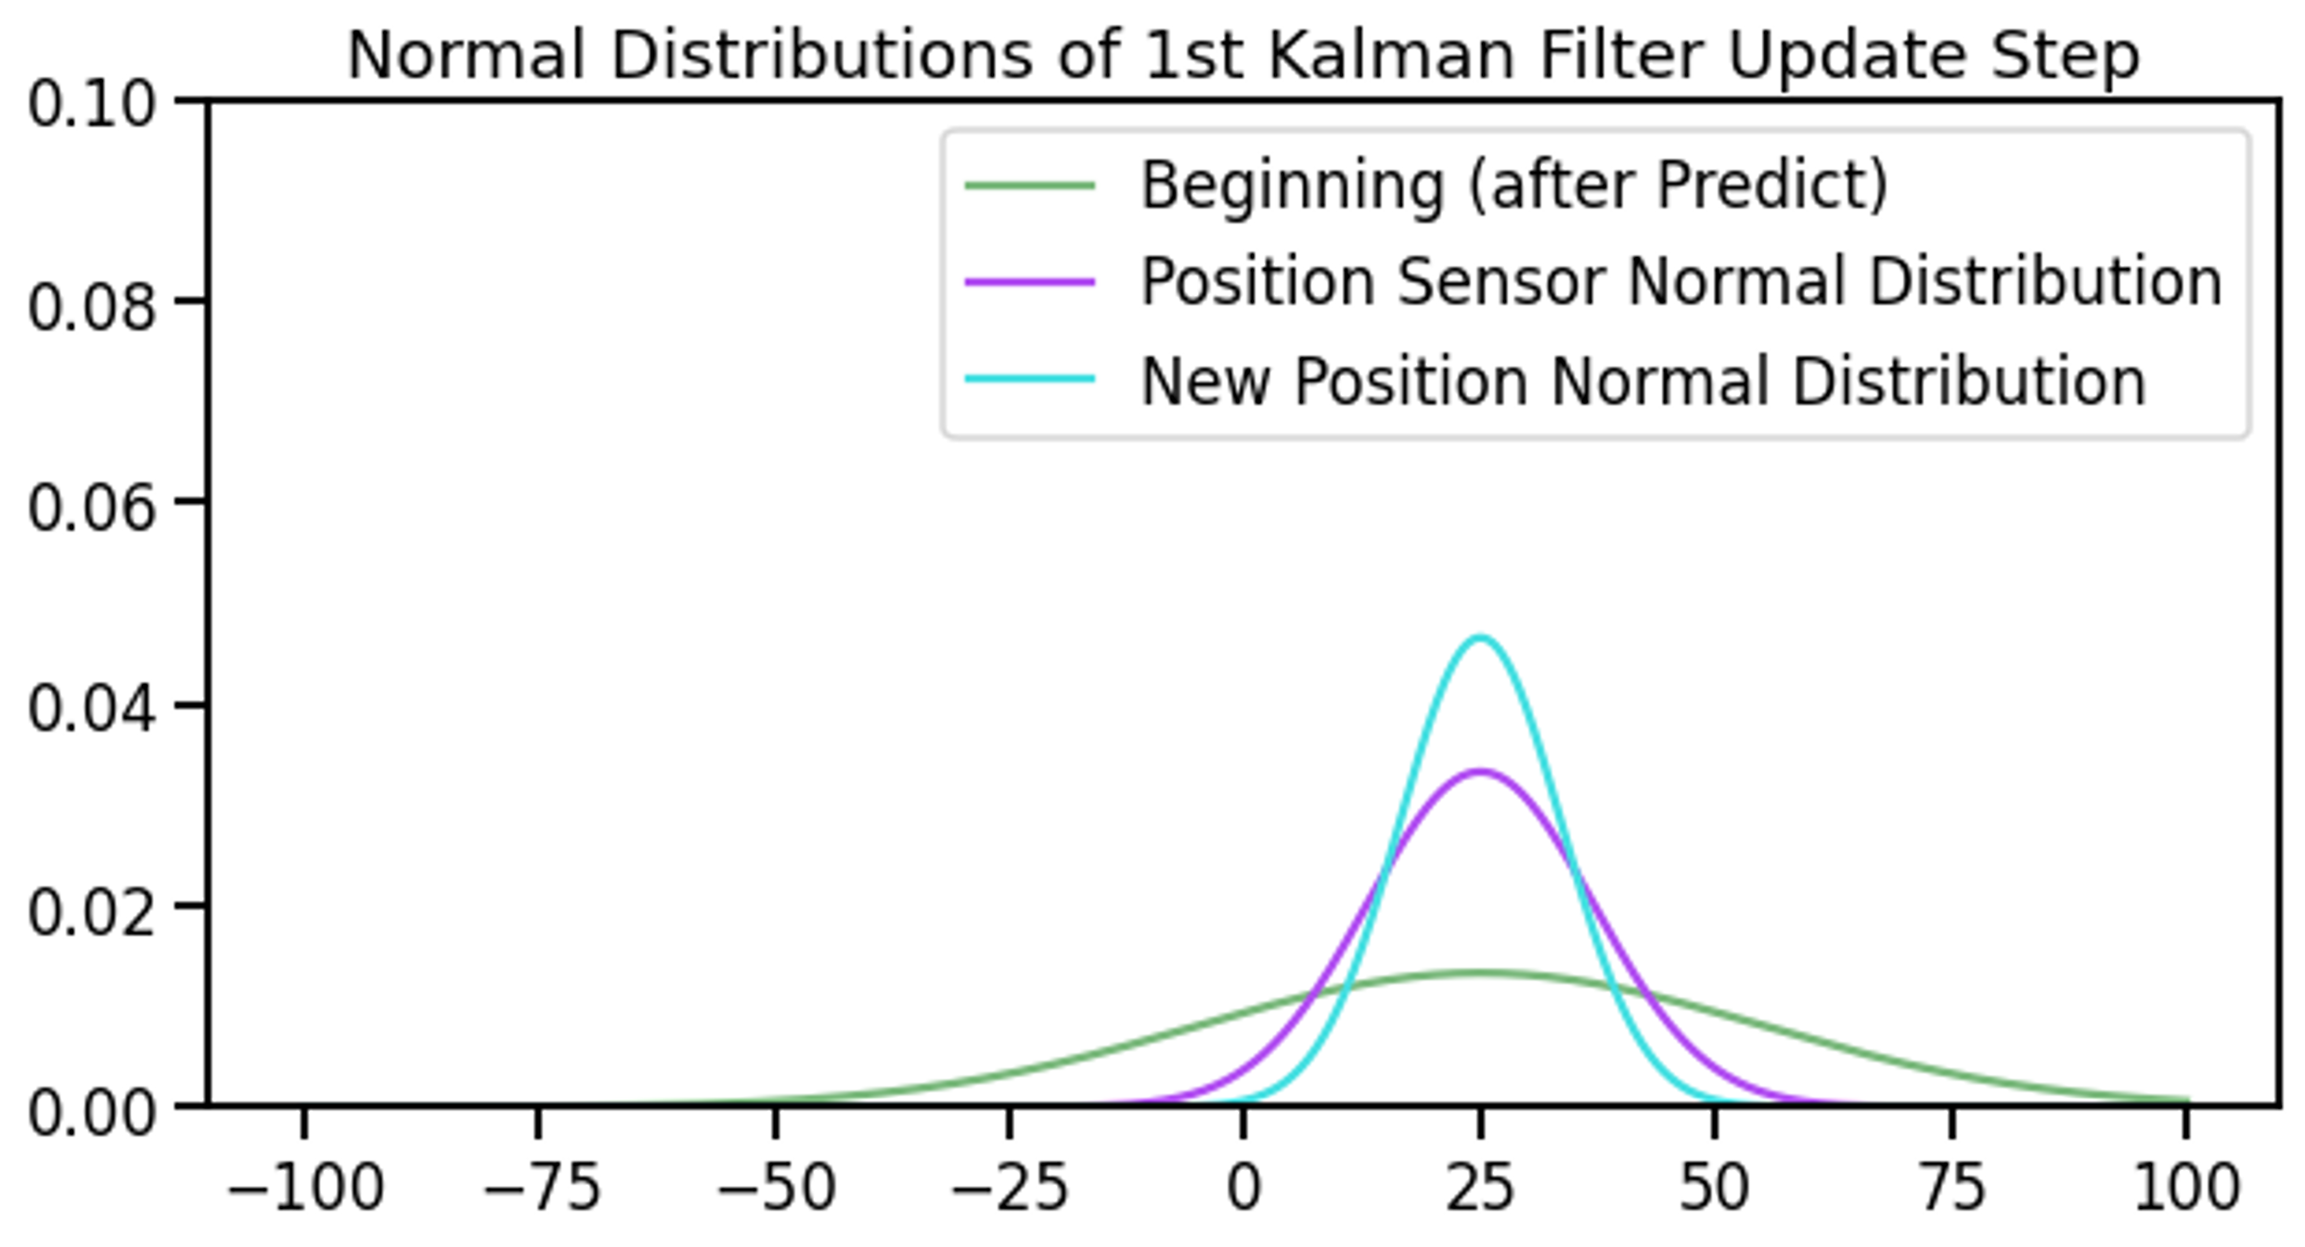
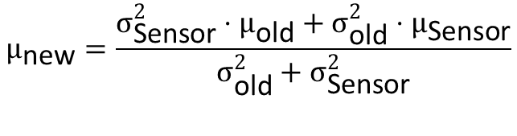
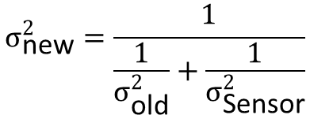
Kalman-Filter explained
$$σ_{\text{new}}^{2}=\frac{1}{\frac{1}{σ_{\text{old}}^{2}}+\frac{1}{σ_{\text{Sensor}}^{2}}}$$
$$μ_{\text{new}}=\frac{σ_{\text{Sensor}}^{2}⋅μ_{\text{old}}+σ_{\text{old}}^{2}⋅μ_{\text{Sensor}}}{σ_{\text{old}}^{2}+σ_{\text{Sensor}}^{2}}$$

Slide 19
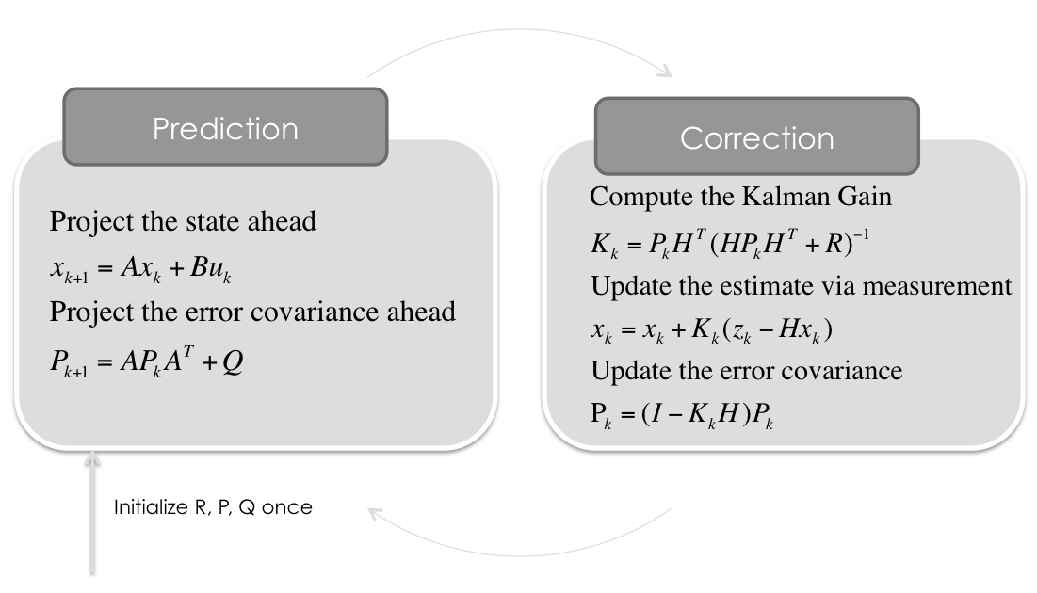
Kalman Flowchart
Notes:
A = 1, da nächste Winkelgeschwindigkeit gleich aktuelle (Ruhelage)
B: Entfällt, da kein Steuersignal
H = 1, Messung immer mit Rauschen
Zk = Messung
Pk = Fehler-Kovarianz
R = Varianz der Messergebnisse

Slide 20
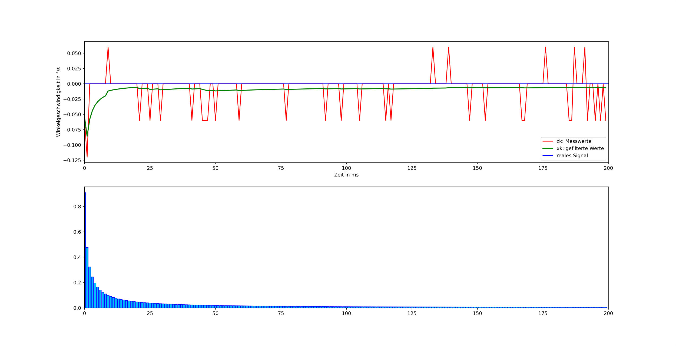
Normal sensor noise

Slide 21
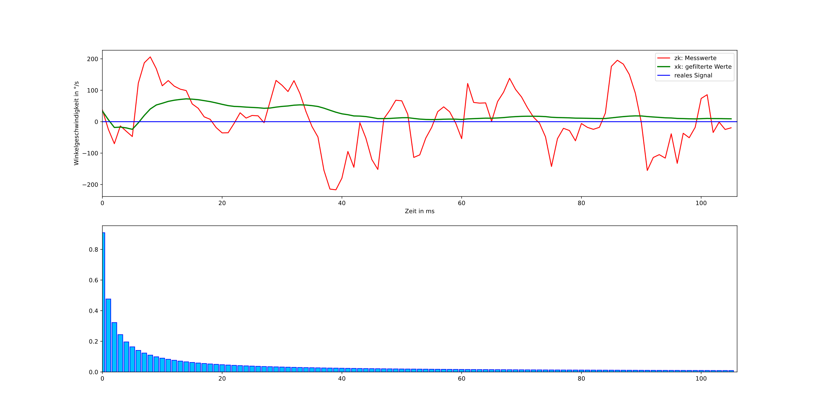
External noise

